Slide 1


FRANCHISE COMPLIANCE HEALTH CHECK
MAINTAINING OPERATIONAL STANDARDS AND SUPPORTING FRANCHISEE SUCCESS
OBJECTIVE:
To ensure all UAC franchise clubs comply with operational, brand, and safety standards through a standardized quarterly audit process.
PROCESS FLOW
Step 1: Access the Audit Form
  Click the official JotForm link https://form.jotform.com/252348875142462 or scan the QR Code
Step 2: Enter Audit Details
  Fill in all required information accurately.
  Ensure the correct staff email of the person conducting the audit is entered.
Step 3: Complete the Audit Checklist
  For each question, select Yes or No.
  Add notes or remarks where necessary.
  Attach supporting photos or documents where relevant.
Step 4: Review & Submit
  Review all details before final submission.
  Click Submit.
  A “Thank You” notification will appear once the audit is successfully completed.
Step 5: Receive Audit Summary
  The staff who initiated the audit will automatically receive a copy of the completed audit summary via email.
  The Master Franchisee will also receive a copy of each submitted form.
Step 6: Share with Franchisee/Club Operator
  The auditor may forward the audit summary email to the relevant franchisee or club operator for their records.
Step 7: Consolidated Reporting
  The Master Franchisee will have access to an Excel summary of all audits via Google Sheets.
https://docs.google.com/spreadsheets/d/1-Z-724SEbMttaTj5MBwLxcIORvEQUNPPQLh34vN25mQ/edit
  A Quarterly PDF Consolidated Report will be generated and sent to the Master Franchisee for official record-keeping.

Slide 2
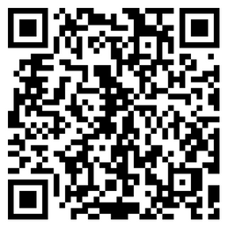
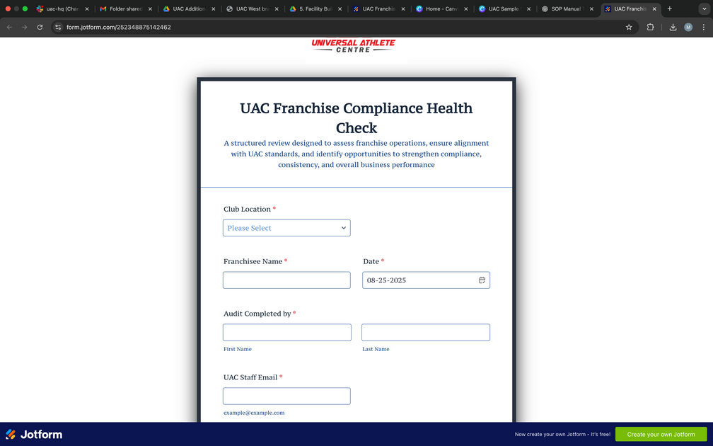
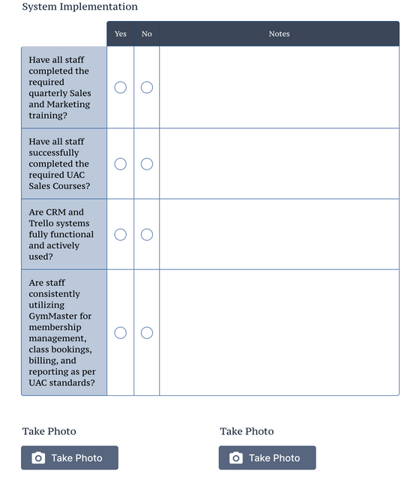

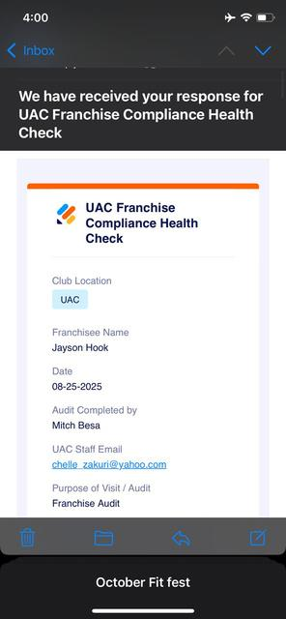

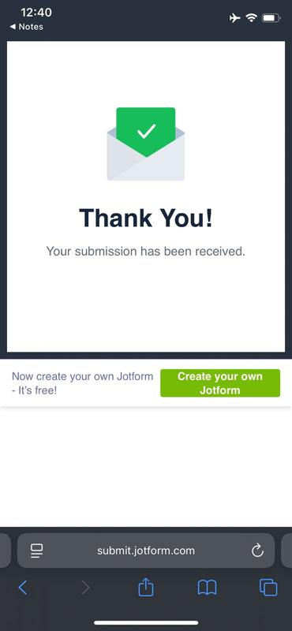
QUARTERLY FRANCHISE COMPLIANCE HEALTH CHECK
MAINTAINING OPERATIONAL STANDARDS AND SUPPORTING FRANCHISEE SUCCESS
STEP 1
STEP 2
STEP 3
Access the Audit Form
Enter Audit Details
Complete Audit Checklist
Click the official JotForm link https://form.jotform.com/252348875142462 or scan the QR Code
Fill in all required information accurately.
Ensure the correct staff email of the person conducting the audit is entered.
For each question, select Yes or No.
Add notes or remarks where necessary.
Attach supporting photos or documents where relevant.
STEP 4
STEP 5
STEP 6
Review and Submit
Receive Audit Summary
Share with Franchisee / Operator
Review all details before final submission. Click Submit.
A “Thank You” notification will appear once the audit is successfully completed.
The staff who initiated the audit will automatically receive a copy of the completed audit summary via email.
The Master Franchisee will also receive a copy of each submitted form.
The auditor may forward the audit summary email to the relevant franchisee or club operator for their records.
STEP 7
The Master Franchisee will have access to an Excel summary of all audits via Google Sheets.
https://docs.google.com/spreadsheets/d/1-Z-724SEbMttaTj5MBwLxcIORvEQUNPPQLh34vN25mQ/edit
A Quarterly PDF Consolidated Report will be generated and sent to the Master Franchisee for official record-keeping.
Consolidated Reporting

Slide 3


FRANCHISEE
Memorandum
Subject: Quarterly Franchise Compliance Health Check
Date: Sept 1, 2025
To: All Franchisees & Club Operators
From: UAC Master Franchisee Office
Dear Franchisee,
As part of our commitment to maintaining UAC’s brand standards, operational excellence, and member experience, we are rolling out the Quarterly Franchise Compliance Health Check across all clubs.
This initiative ensures that every location is aligned with UAC’s systems, safety protocols, and brand presentation, while also identifying areas where additional support or training may be required.
What You Need to Know
  Frequency: Once every quarter (4x annually)
  Tool: Audit will be conducted through an online JotForm link provided to your club
  Process:
    Assigned staff completes the online audit form
    Photos and notes can be attached for clarity
    Audit results are automatically emailed to both the auditor and Master Franchisee
    A consolidated quarterly report will be shared with leadership
Your Role
  Ensure designated staff complete the audit honestly and accurately
  Review audit summaries sent to your email and action any required improvements
  Collaborate with Master Franchisee where support is needed
Why This Matters
The Health Check is designed not only for compliance, but also as a support tool to help your club thrive by:
  Maintaining a safe and consistent environment for members
  Upholding UAC’s brand reputation across all locations
  Identifying opportunities for operational improvements
We appreciate your cooperation and commitment to keeping UAC at the highest standard. Together, we ensure that our franchise system continues to deliver quality, consistency, and excellence to every member, every day.
Jayson Hook
CEO & FOUNDER

Slide 4
SPECIAL LINKS:
Kindly see link to the following:
Collaborator Link to edit the form - https://www.jotform.com/build/252348875142462?iak=f289b22d286ce4d817bca503946d3391-5c57c83c9aab290f
Live Link of the Audit form - https://form.jotform.com/252348875142462
Responses Spreadsheet (editor) - https://docs.google.com/spreadsheets/d/1-Z-724SEbMttaTj5MBwLxcIORvEQUNPPQLh34vN25mQ/edit?usp=sharing
UAC Franchise Compliance Health Check Docs - https://drive.google.com/drive/folders/11_WNT3GpE383N3zO2hSTP2wJaSgodOWs?usp=sharing
D

